Slide 1
Dissecting EDR: an APT Handbook
By Logan Hoag

Slide 2
whoami
Purdue Cybersecurity Graduate in May
OSCP Certified
Avid Golfer & Musician
New tech & Startups
Research Topics:
AV/EDR bypasses
Low Level Security
AI/ML Integration

Slide 3
Agenda
EDR Architecture
Kernel Driver Callbacks
Filesystem Minifilters
Network Filters
User-Mode DLL Hooks
Scanners
Final Payload
Demonstration & Results

Slide 4
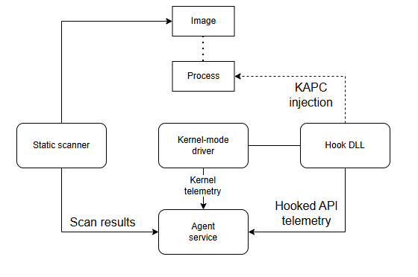
EDR Architecture

Slide 5
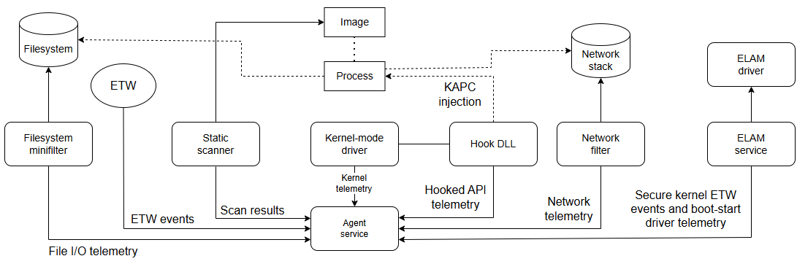
Modern EDR ARCHITECTURE

Slide 6
Process Notifications
Callback routine set with nt!PsSetCreateProcessNotifyRoutineEx()
Process Created --> nt!PsCallProcessNotifyRoutines()
A new callback routine is registered it is added to an array of EX_FAST_REF structures
Information Collected:
ParentProcessId & CreatingThreadId
FileObject
ImageFileName
CommandLine
FileOpenNameAvailable

Slide 7
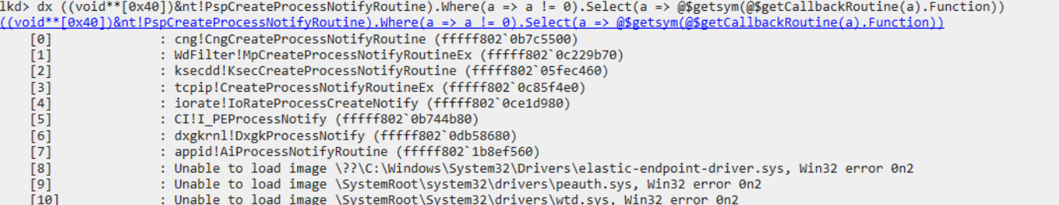
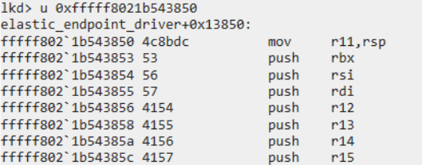
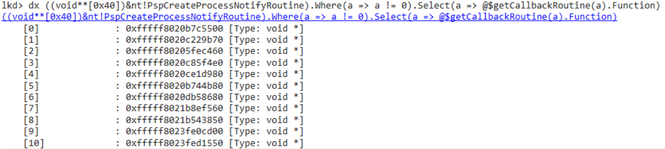
Enumerating Process Notifications

Slide 8
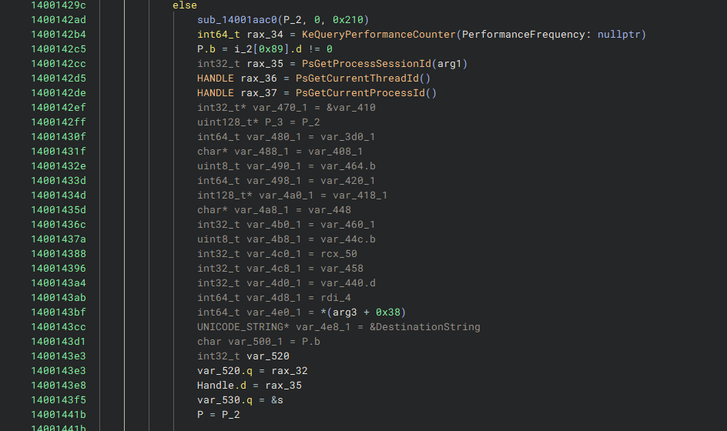
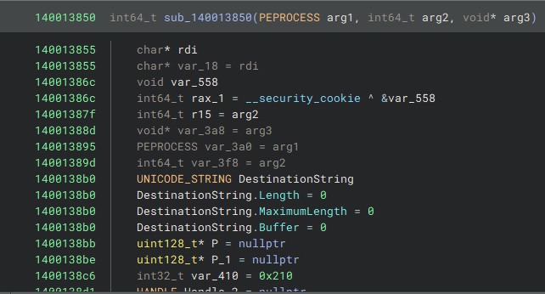
Elastic Endpoint Process callback

Slide 9
Thread Notifications
Callback routine set with nt!PsSetCreateThreadNotifyRoutine()
Less info available than Process Notifications
Detecting remote thread creation:
? Current Process ID == Process ID passed to Thread Callback
Parent Process ID Spoofing
CreatingThreadId.UniqueProcess will contain the true PID

Slide 10
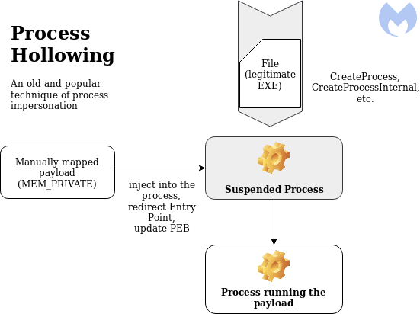
Evading Process & THread Notifications
Type | Technique
Hollowing | map -> modify section -> execute
Doppleganging | transact -> write -> map -> rollback -> execute
Herpaderping | write -> map -> modify -> execute -> close
Ghosting | delete pending -> write -> map -> close(delete) -> execute

Slide 11
The problem
Requires creation of an image that differs from the reported executable!
Heavily signatured: Mapping & Unmapping sections, creating suspended processes
Attackers may be able to alter the PEB, but not the EPROCESS structure
Important Attributes:
ImageFileName
ImageFilePointer.FileName: Win32 filepath
SeAuditProcessCreationInfo.ImageFileName: Full NT path
ImagePathHash: Hashed NT path

Slide 12
Detecting Process Image Modification
Is the SeAuditProcessCreationInfo.ImageFileName empty?
Is ImageFileName a .tmp file?
Does the VAD mapped allocations show a .tmp file?
Mismatch between a process's PEB & contents of EPROCESS == take ACTION!

Slide 13
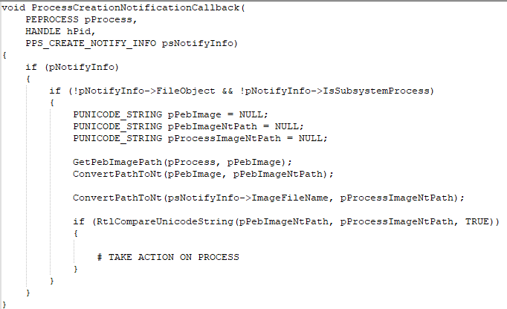
Example Kernel Detection

Slide 14
what do we do?
Don't use process image modification!
Avoid causing process & thread notifications
Only create if it makes sense:
Sysmon.exe creates a thread in chrome.exe
Have other benign applications do the dirty work
Notes:
Zoom and chrome are signed binaries

Slide 15
Object Notifications
Callback routine registered with nt!ObRegisterCallbacks()
Called when opening a handle to a process, thread, desktop, etc.
EDR Kernel Developer must decide:
What type of object to monitor
What operation to monitor: handle creation or duplication
PreOperation vs PostOperation callback routine
Important PreOperation Information Obtained:
Pointer to the desired object
OB_PRE_OPERATION_PARAMETERS structure: DesiredAccess
Notes:
Preventing dumping memory from lsass, which is common to retireve local passwords with mimikatz, because the attacker must first open a handle lsass and request access with process_all_access, the driver could then remove the user from accessing

Slide 16
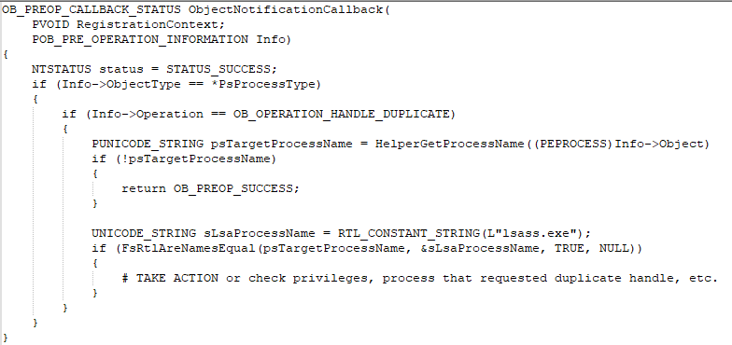
Using EDR logic against itself
Duplicating a handle with the necessary privileges
Enumerate list of open handles on the system with ntdll!NtQuerySystemInformation()
Obtain Image Name -> Check Access Rights -> Benefit?!?
Notes:
Duplicating handle can be viable for lesser known edrs, but crowdstrike no go
Launch thread into process that is legitamate for lsass then request rights

Slide 17
Image load notifications
An executable, DLL, or Driver is loaded into memory -> nt!PsSetLoadImageNotifyRoutine()
Technically a "PostOperation" callback
Generally used for further investigation:
Provided the ImageBase address
Useful for placing User Mode DLL Hooks
KAPC Injection

Slide 18
Filesystem Minifilters
Filesystem I/O Events: Creating files, Reading Files, Creating Named Pipes, etc.
Often works with the Agent Scanner
Common Detections:
Filesystem Canaries
Catching Named Pipe creation from atypical processes
Notes:
Named pipes used by cobalt strike, token impersonation for privilege escalation often uses named pipes. Anonymous pipes with using a sacrificial process that commonly uses anonymous pipes like firefox is the defacto technique for evading filesystem minifilters

Slide 19
Network Filters
Host-based integration allows for more context: Originating Process, User, Activities prior
Modern Filters utilize the Windows Filtering Platform (WFP)
Filtering at the Network & Transport layer
Deep-packet inspection through Callout Drivers
Examples:
An atypical process establishing connections to multiple ports
Unsigned process making outbound network connections
Large data transfers to cloud domains from an unknown process

Slide 20
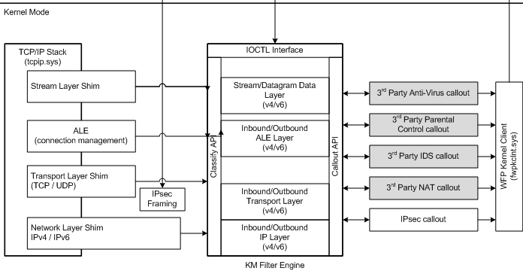
WFP Architecture

Slide 21
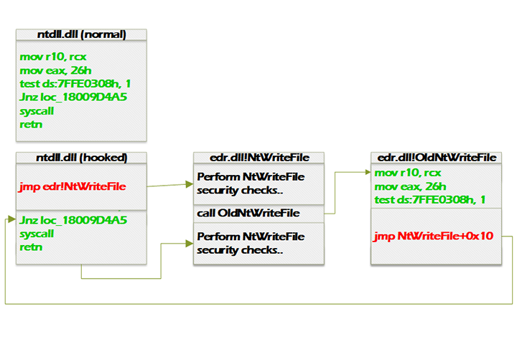
User-mode DLL Hooks
Usually hooked in NTDLL before syscall
Typical functions hooked:
NtAllocateVirtualMemory()
NtProtectVirtualMemory()
NtQueueApcThread()
Can be extremely valuable to EDR:
Arguments passed
Desired memory access
Security checks before operation

Slide 22
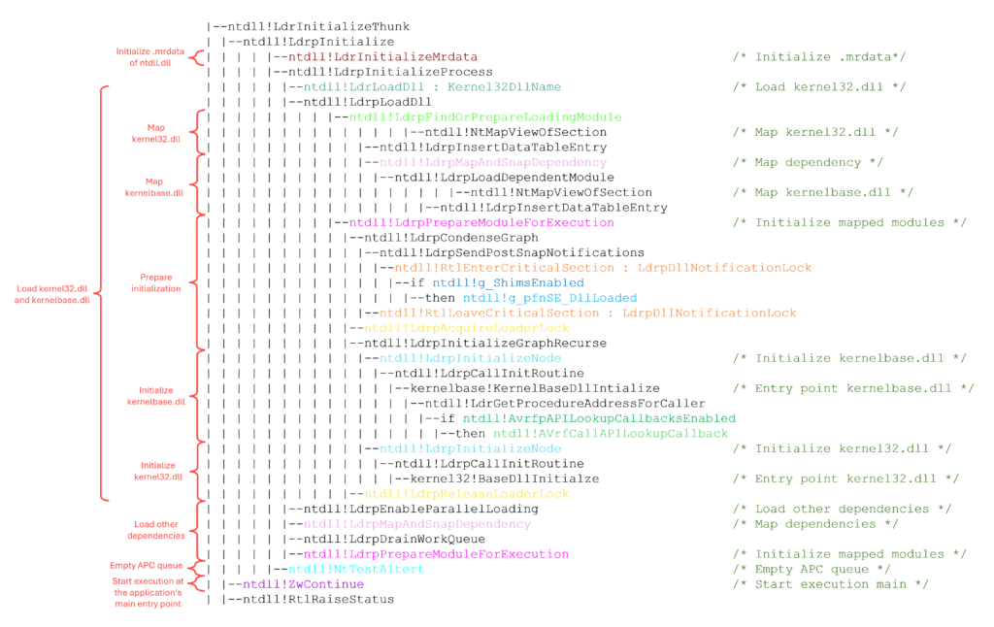
LDr Initialize Thunk Call graph

Slide 23
Defeating API hooks
There have been HUNDREDS of bypass techniques over the years
Cat & mouse game between attackers & defenders:
Direct Syscalls, June 2019 / Detections: May 2023
Indirect Syscalls, June 2021 / Detections: February 2024
Syscalls via Vector Exception Handlers: August 2022 / Detections: July 2024?
Early Cascade Injection: October 2024 / Detections: None
Using custom functions rather than the WINAPI
Ex. custom GetModuleHandle() & GetProcAddress()

Slide 24
Anti-virus (SCanners)
Paired with the Filesystem Minifilter & Kernel Driver Agent
Historically using "signatures" for rulesets
Over 200,000 signatures alone in Microsoft Defender
Majority of EDR's implement thousands of YARA rules
However, the game has changed...
Notes:
Signatures include strings, hashes of sections of a file, imports and exports, series of opcodes

Slide 25
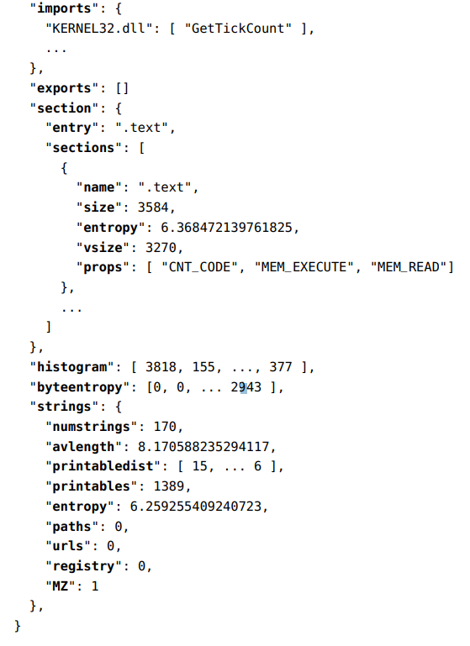
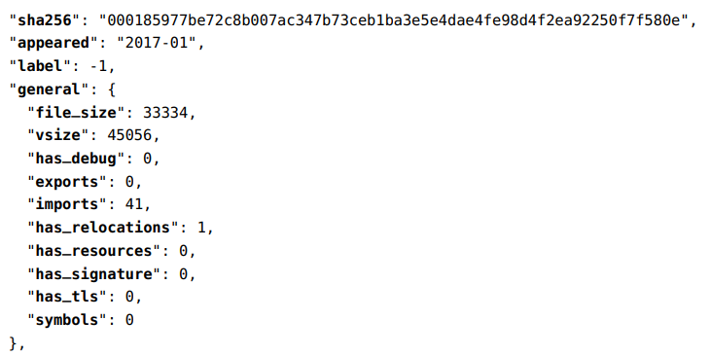
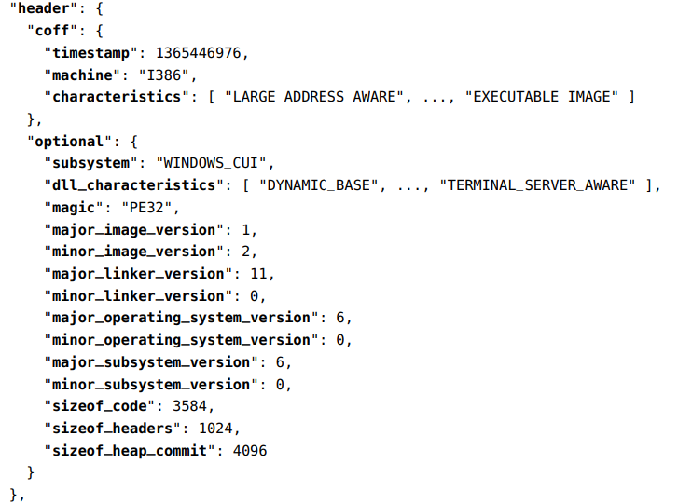
Ai/ML integration
Models trained on static & heuristic attributes
Static features: binary entropy, headers, imports, exports, strings, stub data
Heuristic features: API call sequences, Process Tree, Network Traffic
Achieved ~92% accuracy off static features alone

Slide 26
Flying under the radar
Static:
String / API Hashing
Pseudo Handles
Payload Encryption
Compile Time Hashing / Generation of Keys
Lower Binary Entropy
Removal of the CRT Library (Very hard)
Dynamic / Heuristic:
Execution through BOF's
Call Stack Spoofing
Sleep Obfuscation

Slide 27
THE PAYLOAD

Slide 28
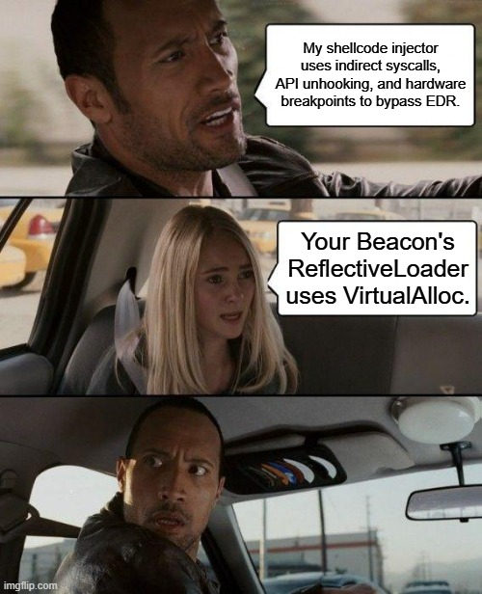
Defense Technique | Evasion Technique
Process & Thread Notifications | Inject to/from a process that makes sense
Object Notifications | Launch thread into process that is legitimate for lsass then request rights
Network filters | Random check in times
User-Mode DLL Hooks | Early Cascade Injection + Syscalls via VEH + HWBPs + Custom Functions
YARA Rules | String / API Hashing, Pseudo Handles, Payload Encryption, Compile Time Hashing / Generation of Keys, Lower Binary Entropy
Heuristic Scanning | Execution utilizing BOFs, Call Stack Spoofing, Sleep Obfuscation
AI / ML Scanning | Random execution of functions

Slide 29
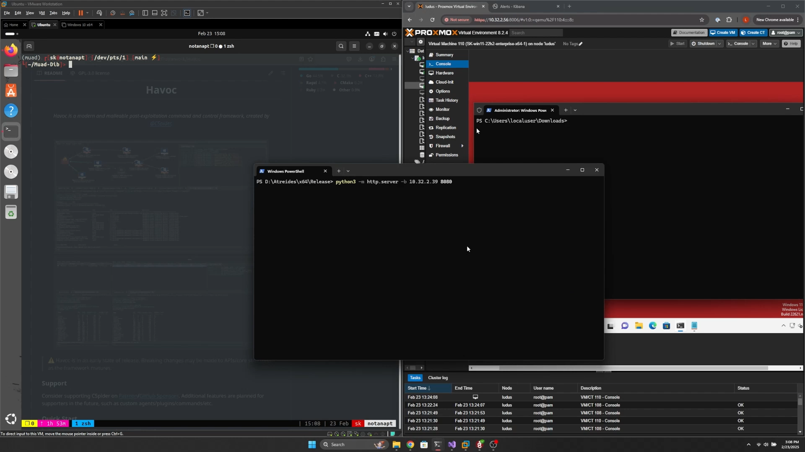
Demonstration

Slide 30
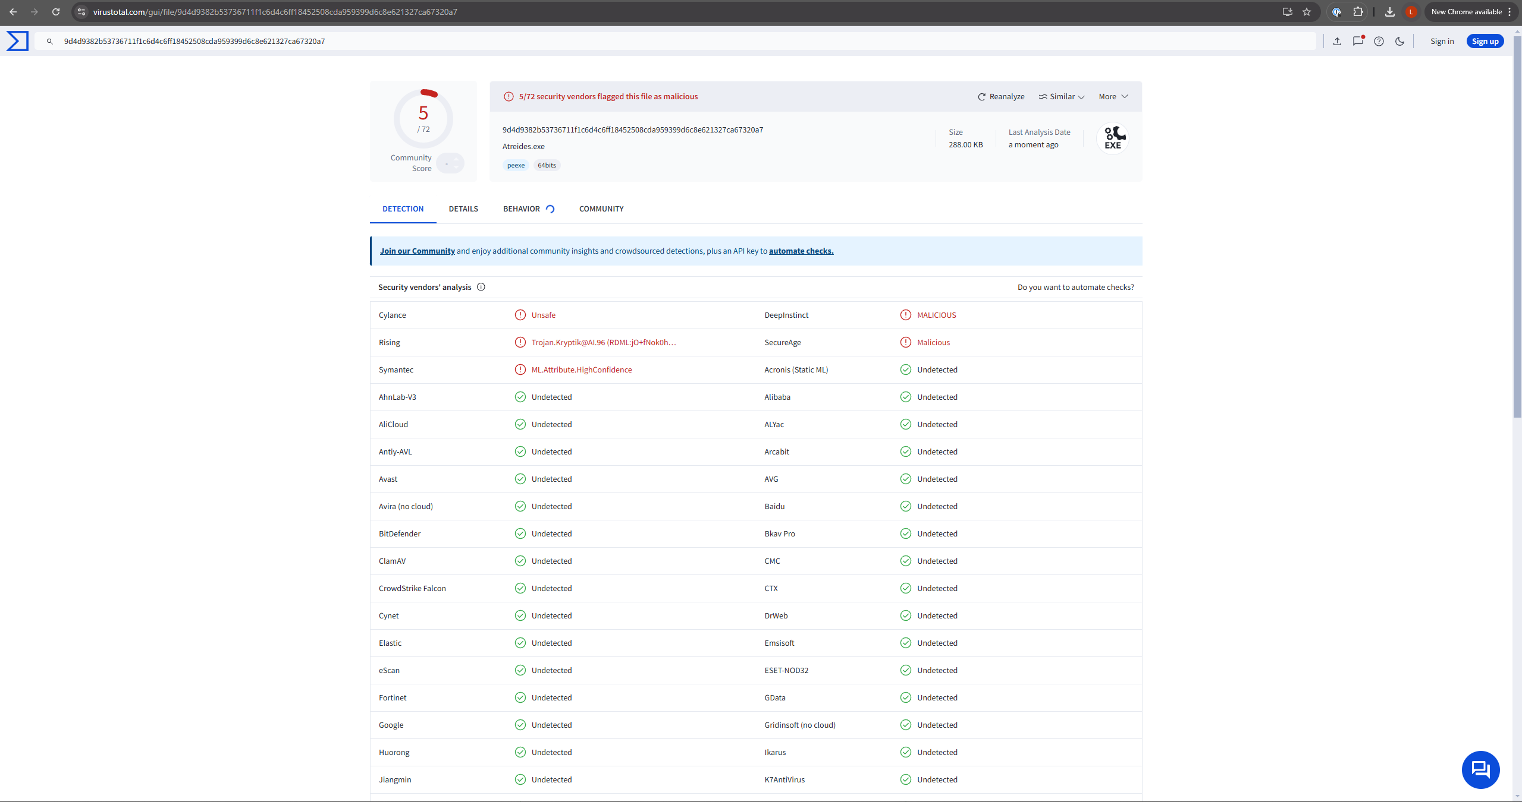
Results

Slide 31
THANK yoU

